Slide 1
Tank Game 2021
Blake Jones – st20179232

Slide 2
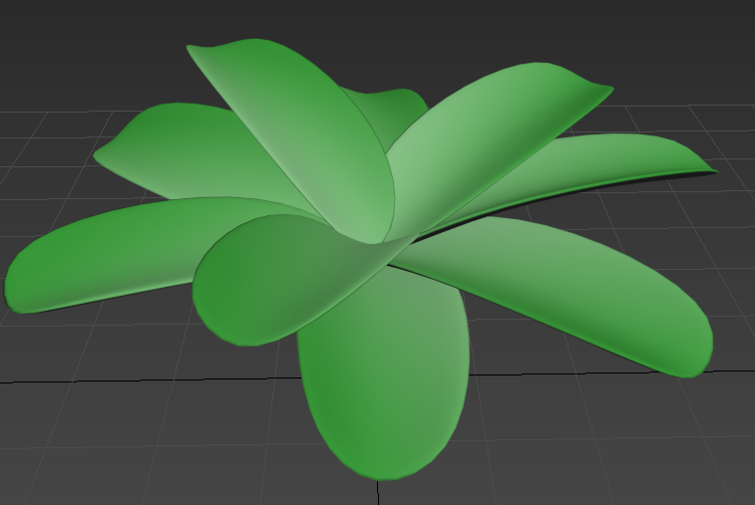
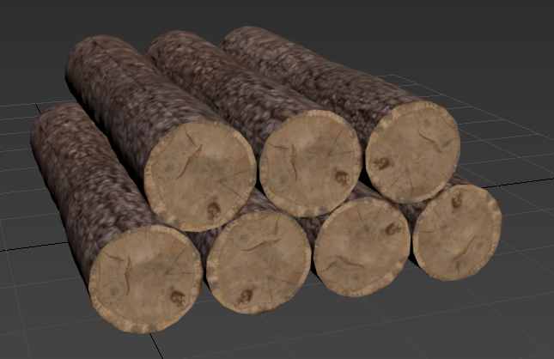
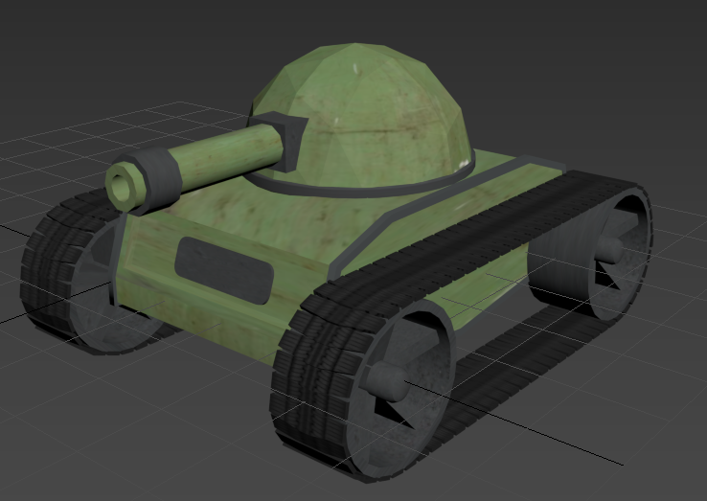
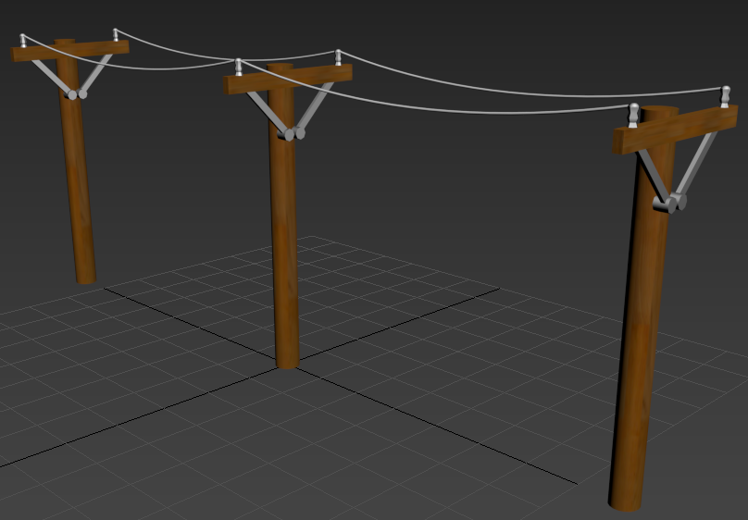
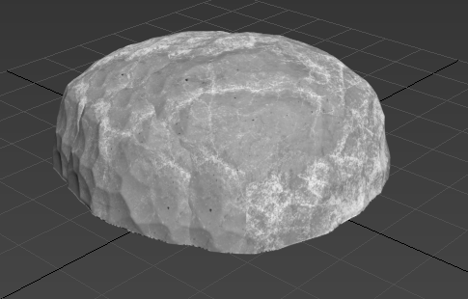
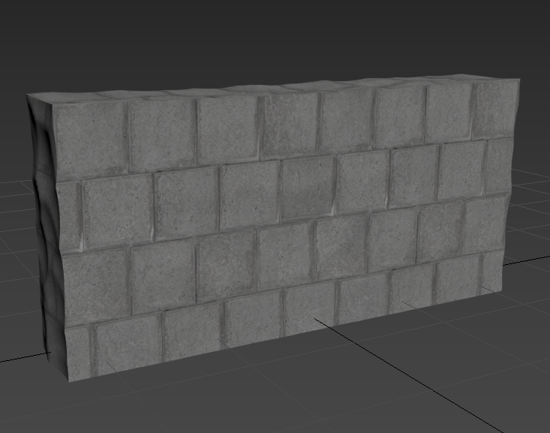
Modelling

Slide 3
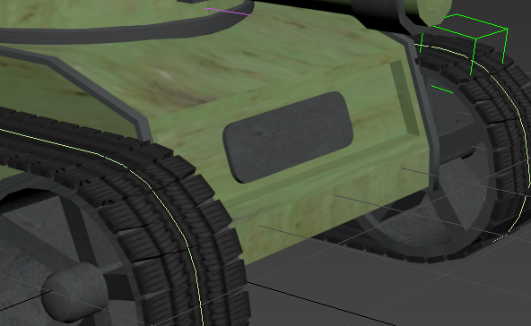
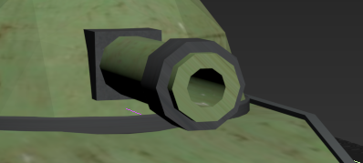
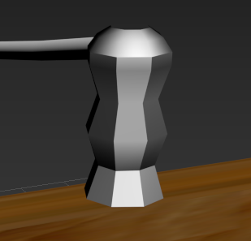
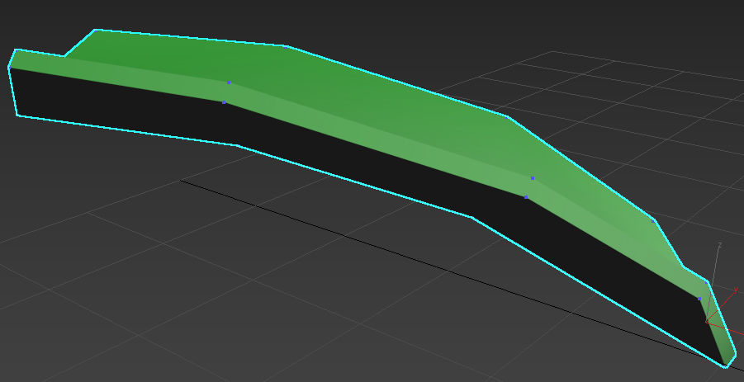
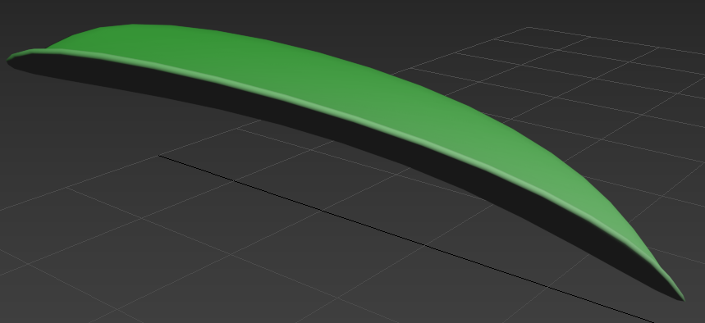
Polygon Modelling
Chamfer – I used the chamfer tool to round different edges on my models such as the number plate
of the tank but I also used it to create angles to different shapes, so I wasn’t having a model made of
a bunch of boxes.
Proboolean – I used proboolean to hollow out different shapes by creating a clone of the shape I
wanted and then scaling the clone to the size I needed to hollow out the shape I wanted. For example
I created a clone of the barrel, scaled it down then made it longer to completely shell out the inside of
the barrel.
Vertex + Edge Editing – I used edge and vertex editing to make some of the more complex shapes I used such
as leaves and part of the pylons. When creating the leaves, I edited the vertices of a plane to create a boxy
leaf shape which could then be smoothed to create a nice leaf model.
Shell – I used the shell tool to add thickness to the plane I had to add some thickness to the leaf before
rounding it so it wasn’t just a 2d flat leaf.
Turbosmooth – I used turbosmooth a few times to round some of the hard geometric edges I had. This allowed
me to create a nice smooth surface instead of a boxy model.

Slide 4
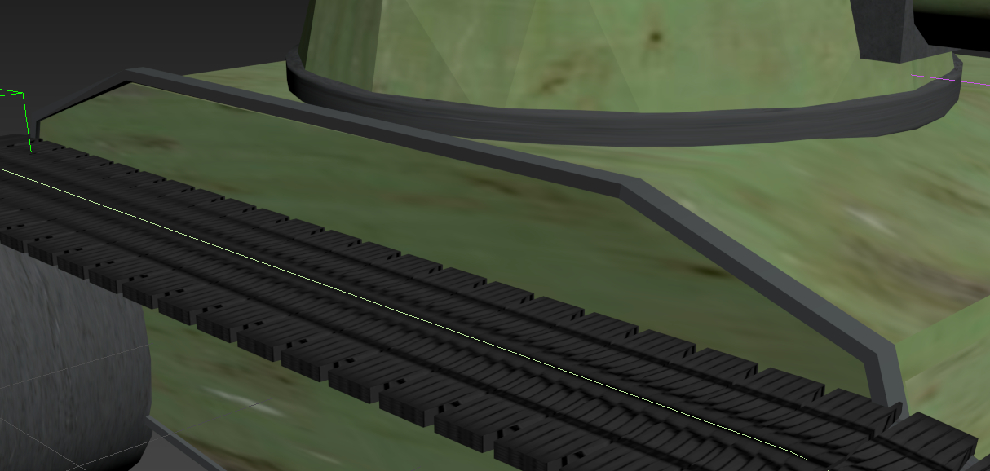
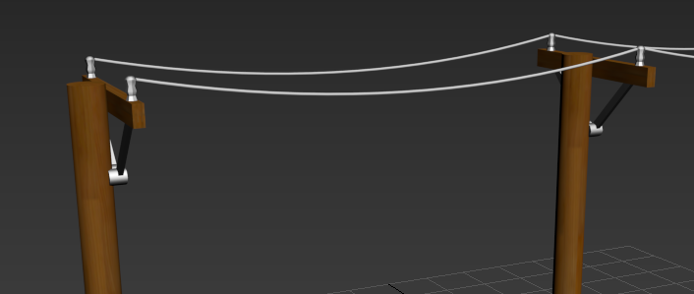
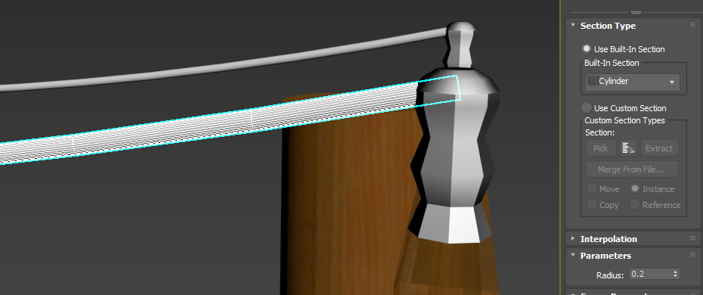
Spline Modelling
Lines – I used lines to add detailing to the tank model, I added points at the corners to create a line that followed the edge of body of the tank. These lines would go on to add an extruded outline to add some depth to the body of the tank as it was looking quite flat and boxy.
Arcs – I used arcs to create an effect on the phone lines so that they look more realistic, like they are being affected by gravity. This looks much better than having them run perfectly straight across.
Sweep – I used the sweep tool to turn my lines into solid shapes. For the edging of the tank, I used an angle sweep to keep with the shape of the body. For the wires I used a cylinder sweep to get the round wire shape that follows the arc I had made.

Slide 5
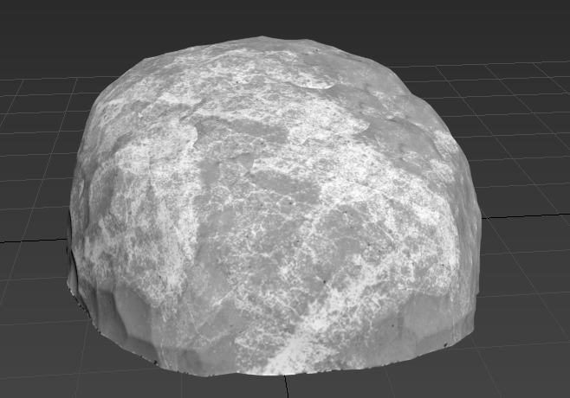
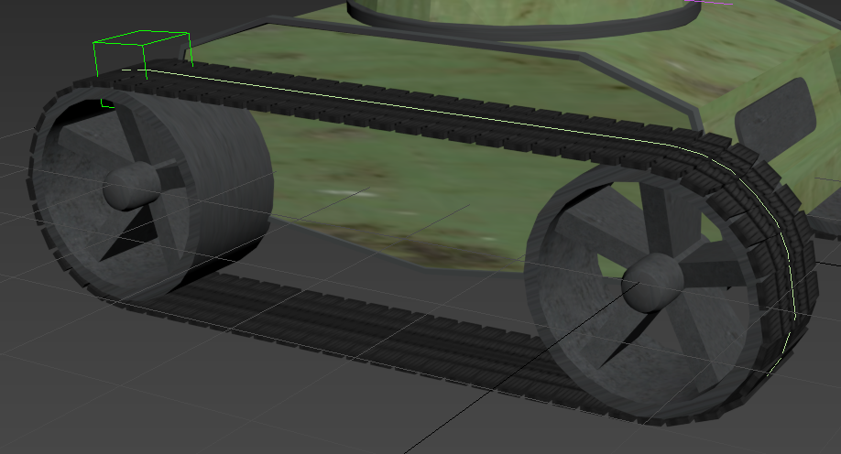
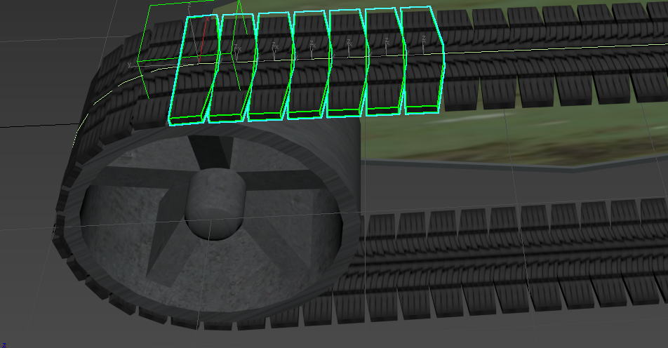
Other Techniques
Displacement Map – I used the displacement tool to create an effect on some of my shapes that they were more natural and detailed. For example, when creating the rock, I added a cellular map to the displacement tool which allowed me turn my geosphere into an organic looking rock.
Dummy + Pathing – For the tire treads I created a path around the tires and added a dummy to follow that path. I could then link my treads to the dummy controller so that all the treads followed the path of the dummy.
Automatic Clone Script – So that I didn’t have to create each individual tread (there are over 150 in total), I created a script that would add a new tread a certain distance along the path after the previous one. After some trial and error, I had treads running all the way around and meeting back at the original tread with no big gaps which creates the illusion of 1 continuous tire tread,

Slide 6
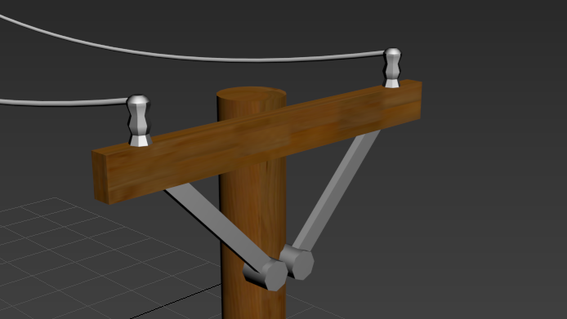
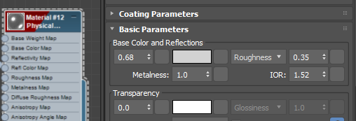
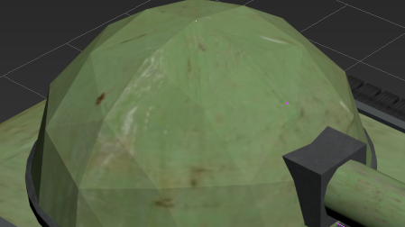
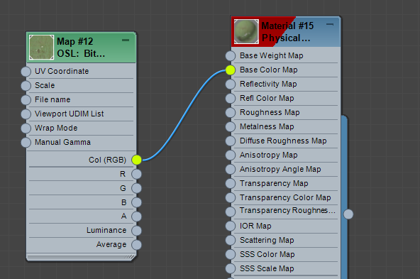
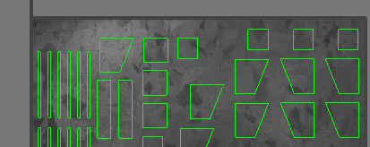
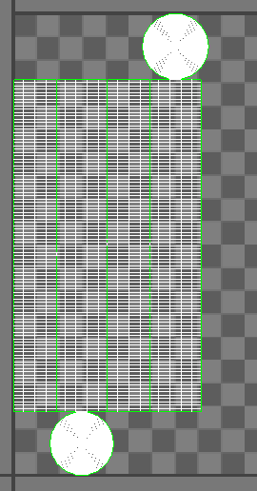
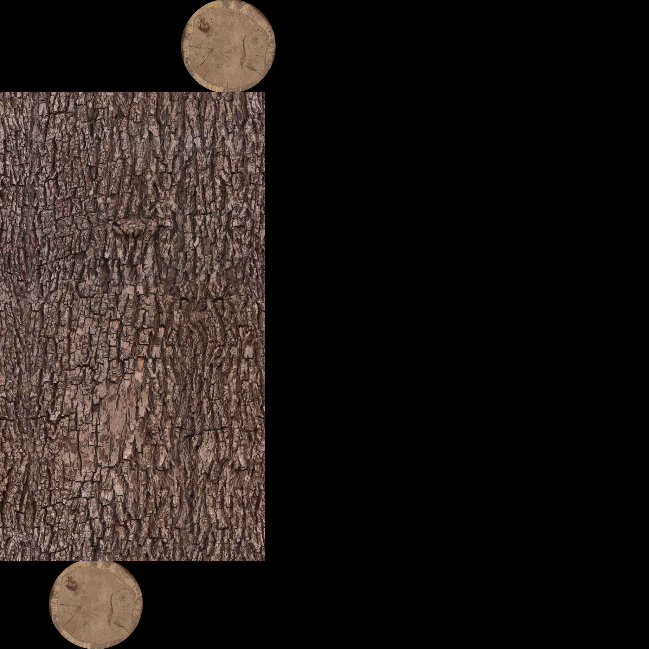
Texturing
Material Editor – The first type of material I used was 3ds max’s own physical materials. These were used for the more basic textures that I needed such as the metal on the pylons where I just needed a grey metal looking material. For this I created a new physical material in the material editor and adjusted the reflections, colour, and roughness values to get a nice-looking metal material
Bitmap Lookup – Some of my other textures needed to be more detailed so I sourced images online and used them to create my materials. Using the bitmap lookup option in the material editor I could set the image as the base colour of the material to add the image to my model.
Unwrap UVW – To move the textures I had imported I used the unwrap UVW tool to move the image to where I wanted to texture to line up to.
Render UVW Template – Using the render template option within the UVW editor I could create an ‘unfolded’ version of my shape and apply the texture directly to it using a third-party application (I used Paint.net). For example, I used this on my log texture to add bark to the main part of the log and slices to the end to look like the log had been cut from a tree and wasn’t just bark all over.

Slide 7
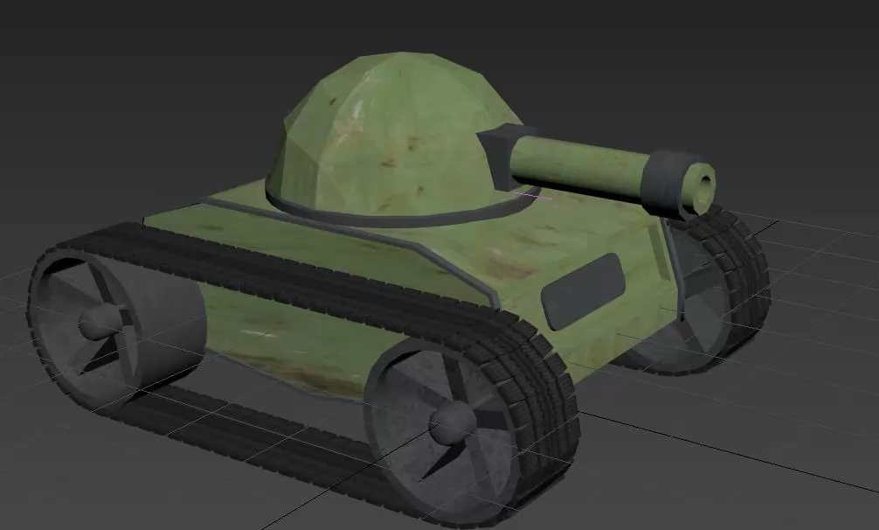
Animating
The animation I created is a combination of the wheels spinning and the tire treads moving forwards around the wheels.
I had to calculate the speed of wheel rotation to match the speed of the treads moving forwards to make 1 smooth continuous animation.

Slide 8
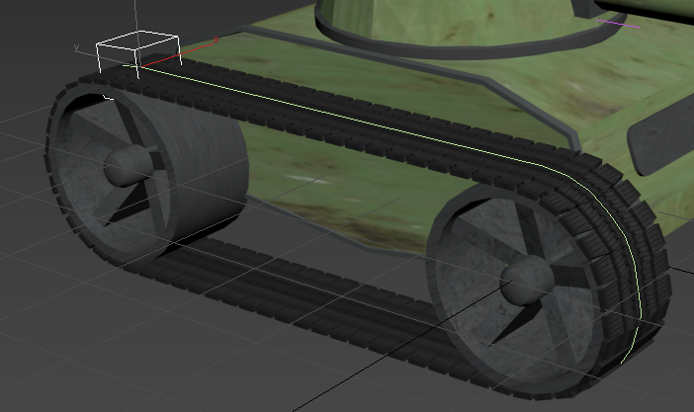
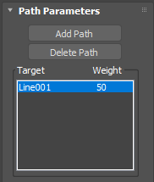
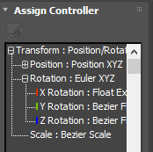
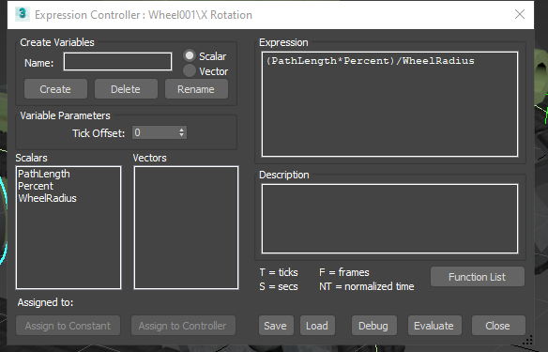
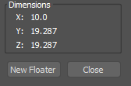
Animation Techniques
Treads Pathing – I created a dummy to follow the line I created around the tires then linked the treads to the dummy controller so that they also follow the same path.
Transform Controller – I used a transport controller to change the X rotation of the tires which made them spin. I used a Float Expression to control how fast the tires should spin. Once I had set the values, I needed the tires spun at the correct speed to match the treads.
Speed calculations – I assigned a float expression controller and used the calculation (PathLength * Percent) / WheelRadius to work out the spinning speed. To get the math length and wheel radius I used the measure tool built into 3ds max.

Slide 9
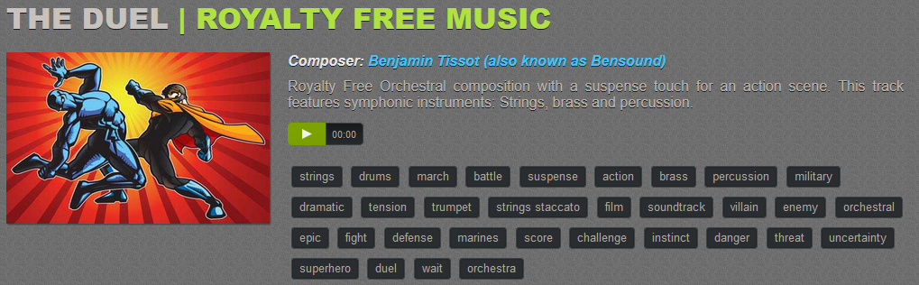
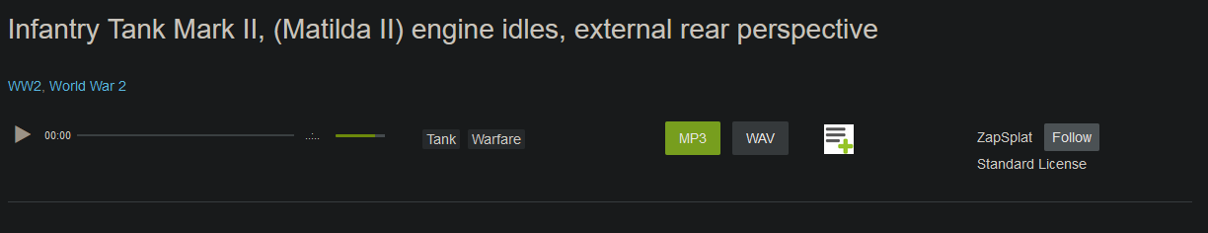
Sound editing

Slide 10
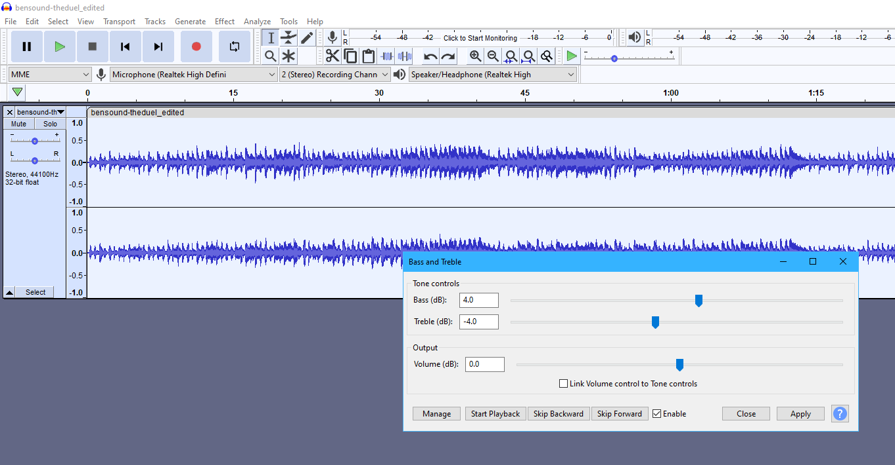
Bass and Treble
Once I had chosen on some background music, I liked I went through and edited the audio track using audacity. First off, I adjusted the bass and treble to make some of the high notes less high pitch and add some more bass the sound. I wanted a track with more bass as it would fit the military tank fighting theme better.

Slide 11
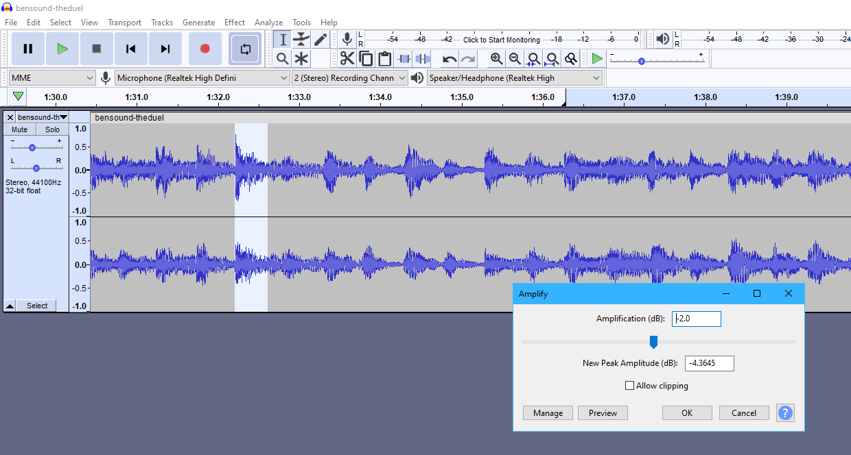
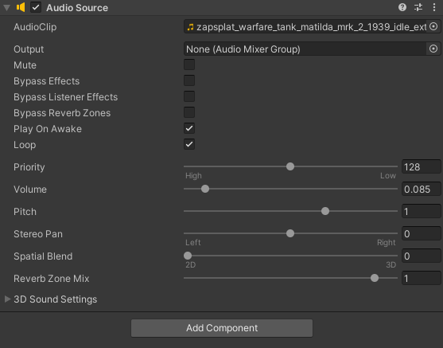
Amplify Sections and Volume Mixing
For the final adjustment of the track, I went through and found all the sections where there was a trumpet or symbol involved. These parts were far too loud compared to the rest of the music, so I used the amplify tool to make these parts closer in volume to the rest of the track.
Once in unity I looped the sounds, so they played on repeat then tested them and adjusted the volume of the audio sources to find a good balance between the tank engine and the background music.

Slide 12
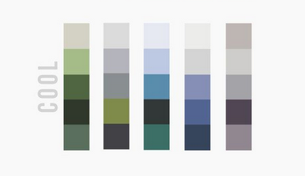
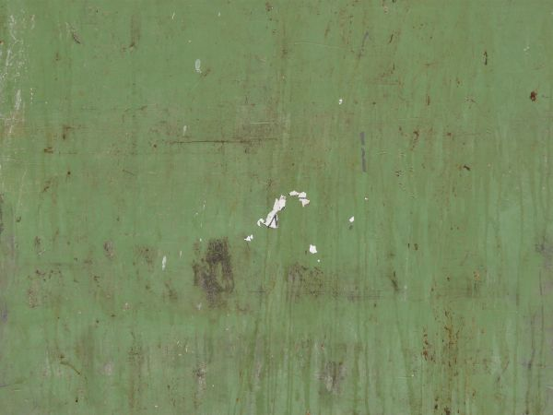
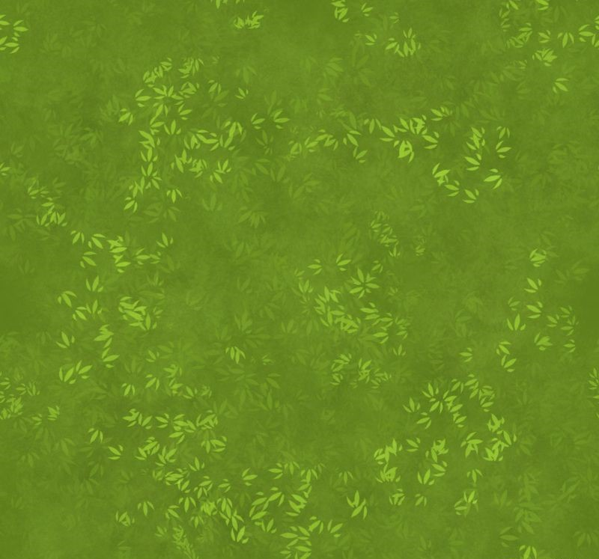

Level Design
To create I maps I needed to use a lot of different tools within Unity, this required:
Importing 3D Models – I imported all the models I had created in 3ds max.
Importing Animation – I brought in the animation I had created in 3ds max.
Importing Sound – I added background sound and a tank engine to the game.
Terrain Editing – I used the terrain editor to add some height to the otherwise flat map.
C# Scripts – I used a movement controller and a camera look controller so the player can move and look around.
Lighting – I used 2 light sources at opposite angles (the secondary one being dimmer and not casting shadows). This prevents the main light source from casting super dark shadows on the back of objects while keeping natural lighting for the scene.
The style of the map uses a cool colour palette of soft colours and cartoony models to keep an arcade style feel to the game. The models aren’t hyper-realistic, which also fits in nicely with the arcade theme.

Slide 13
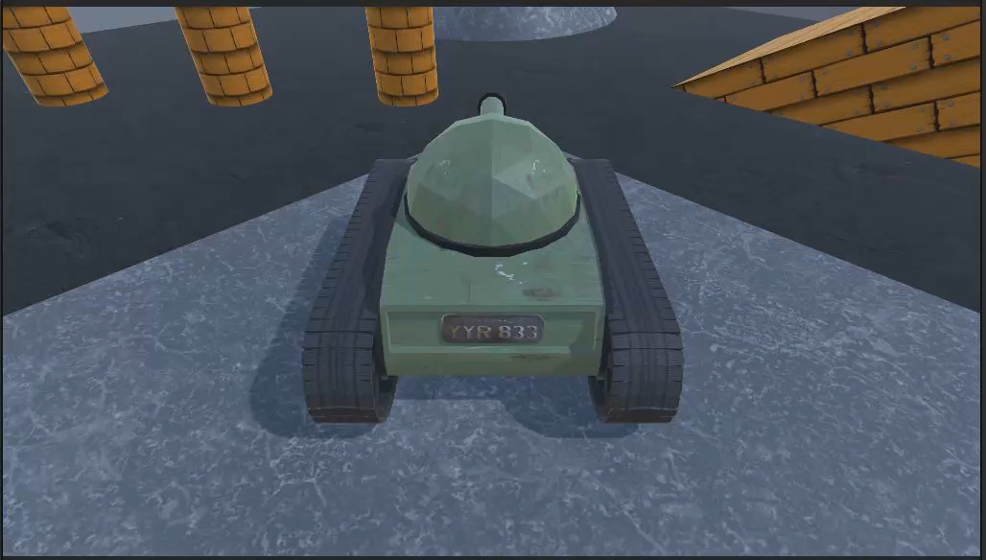
Tutorial Level
The tutorial level is made of basic textured shapes and is only played so the player can get used to the movement mechanics of the game. There are pillars to swerve in and out of, a ramp to climb and fall off, stairs to drop down, and a hill to roll up. The tutorial level is kept simple as it is only really included so that the player can get used to moving around on different terrain in the tank.

Slide 14
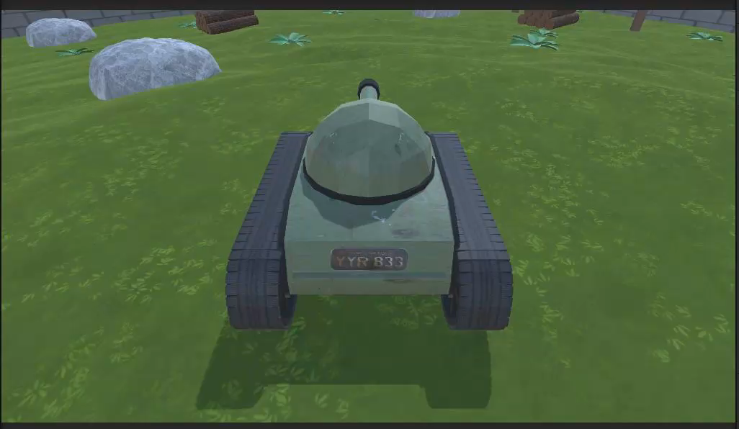
Map 1
Map 1 is set in a field with custom terrain that adds a level of depth the map. There are obstacles such as rocks and log piles for the player to use as cover and outmaneuver the enemy. There are pylons running all the way across the map which provide some cover and can be bumped into, while there were added to detail the map you do not want to get caught crashing into them. The ground is made up of a grass texture with bushes dotted around the field which can be driven over but add another level of detail to the map.

Slide 15
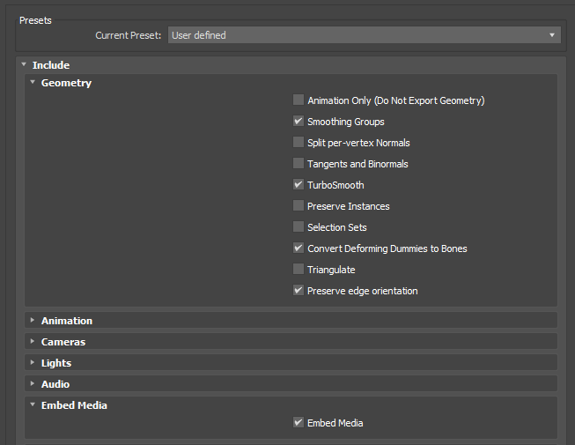
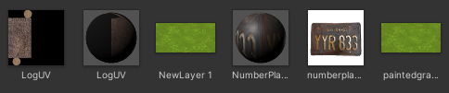
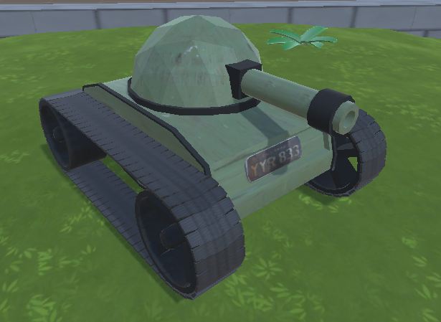
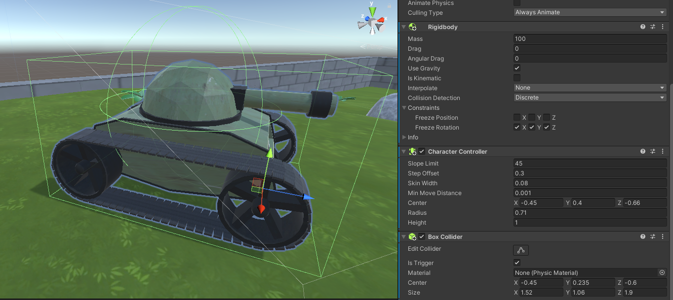
Implementing Models
Convert to FBX – Before I could import the models, I created into unity I had to export them from 3ds max as FBX files and select the export options I wanted.
Unity Materials – Once I drag my FBX files into my unity project I created new materials so that I could apply the textures to my models simply by dragging them where they needed to be.
Resizing and Rotating – Once The models were ready to be added to the scene, I resized them to the appropriate size and rotated them along different axes depending on whether I wanted to turn them, or they needed to be slanted on a hill.
Components – With the model added to the scene I could then add the scripts and components I needed. The obstacles and player were given box colliders, I added movement and camera scripts, character controllers etc.

Slide 16
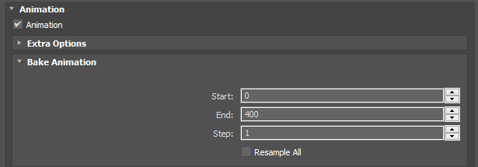
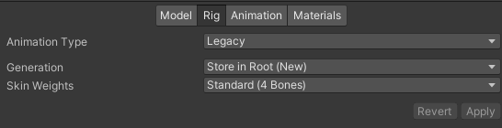
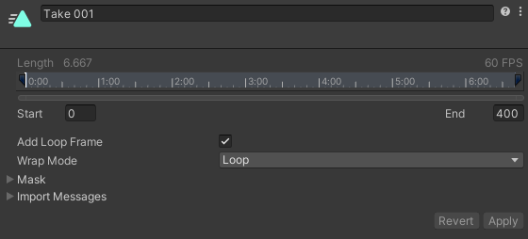
Implementing Animation
Exporting – Once I had created the animation of the tire treads in 3ds max and edited the speed by making the animation longer (this prevented the treads from moving way too fast), I could export the animation with the model by selecting the option to export it too.
Unity animation controller – Once I had my model in Unity, I could select the tank prefab from my ‘ImportedModels’ folder and edit the animation that was imported. First off, selecting the animation type as ‘Legacy’ allows for a smooth 60fps animation. In the animation section I added a loop to the animation so that it will replay once the animation ends so the treads keep moving and the wheels keep turning.

